Slide 1
Effective ways to roll out Infosys Campus Connect Foundation Program
Prof. Purvi B. Soni(purvishah.ce@ddu.ac.in)
Prof. Jigar M. Pandya(jigarpandya.ce@ddu.ac.in)
Dharmsinh Desai University, Nadiad.

Slide 2
Professionalism
Everyday strict timings of starting and ending session was adhered.
Final touch: many minor details were conveyed
Setting up work station/Development environment
Adding bookmark in browser of frequently used sites
Remote computing, Interoperability
Framing quick question to get hint/help from colleagues and not disturb
Care for eyes, back, communication, time management.

Slide 3
Interns, Let us know your details!!
In the “interns list” (made available by TPO), we added a sequence number column and shared with the batch
This number was considered as their student roll # during the complete program.
Used as name of “Assignment Solution Files” to automatically execute sql script for FA2 HandsOn grading, etc.
Used to share participation document, results, etc.

Slide 4
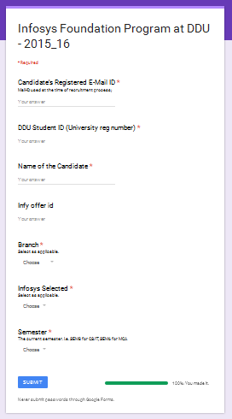
…Use of Google Forms
To collect participant’s information
roll #. (They know this from “KnowYourDetails.pdf”)
Candidate's Registered E-Mail ID *
Mail-ID used at the time of recruitment process;
Student ID (University reg number) *
Name of the Candidate *
This is what will appear on certificate
Infosys offer id
Branch * (CS/IT, Non CS/IT, MCA)
Semester *
The current semester. i.e. SEM8 for CS/IT, SEM6 for MCA
https://www.google.co.in/forms/about/
Share the form on email addresses of all participants.
Responses are then available to us in a spreadsheet
These details were used for
Intern names were fetched using office mail merge feature for participation document
FP Batch Closure (to let CC process certificates)

Slide 5
Moodle course Day to day activities
With reference to Session Plan available in each Focus Area (FA) material
Setup everyday section, post topics and related assignments. Share related campus connect provided pdfs.
Demonstrate tool of the day. Hands on.
Let student upload assignments meeting deadline (Due Date) and delayed (Cut-off date) but marked as late.

Slide 6
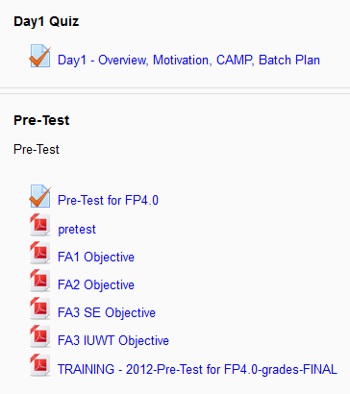
Online Quiz using moodle
Pre-test to “Know, what you don’t know!”
Performance evaluation after all Focus Area and badge distribution. I.e. Terminator, Avengers, Expandables, Spartans, Warriors.
Doubt clearing sessions to improve technical knowledge and skills.
Open up the quiz for unlimited later attempts and review correct answers.
Using moodle aiken format, question text files were imported into question banks (bulk import).
What is the correct answer to this question?
A. Is it this one?
B. Maybe this answer?
C. Possibly this one?
D. Must be this one!
ANSWER: D

Slide 7
Hands-on Quiz, make a difference
Non-traditional way of hands-on quiz
i.e. Reverse Engineering
Given the database tables structure, generate ER Diagram. Manually and automatically both.
Half cooked code:
Behind the scene, From ready UI/Web page source generate snapshots.
Remove few important coding snippets.
Finally, let interns complete the coding to meet requirement as per snapshots from half cooked code.

Slide 8
Demo Software Tools
To keep students interested in attending hands on hours,
everyday during hands-on/assignment solving period,
we spare 15-45 minutes to demonstrate important tools as per industry requirement:
Software Tools:
SSH Client - Putty - http://www.putty.org With help of XMing - http://sourceforge.net/projects/xming/
SSH Client – Xshell Tools/Telnet-SSH-Clients/Xshell-Free.shtml)
Microsoft Project Plan (.mpp) Eclipse IDE for Java - https://eclipse.org/
Version Management System - Subversion (https://subversion.apache.org/) Windows Client (https://tortoisesvn.net/)
Apache Tomcat with localhost:8080 as well as withing eclipse as a server
Google service of reCaptcha.\
Cygwin - https://www.cygwin.com/
Toad - Database Client by Dell
Oracle XE for local machine
sqlldr for importing csv into tables
Tnsping with tnsnames.ora
Squirrel as generic sql client, java -jar to setup and add drivers and test url
imp.exe and exp.exe from oracle bin for import/export database dump
Java decompiler - http://jd.benow.ca/
StarUML
Python IDLE
JUnit with Eclipse mars
Work management system for billing hours

Slide 9
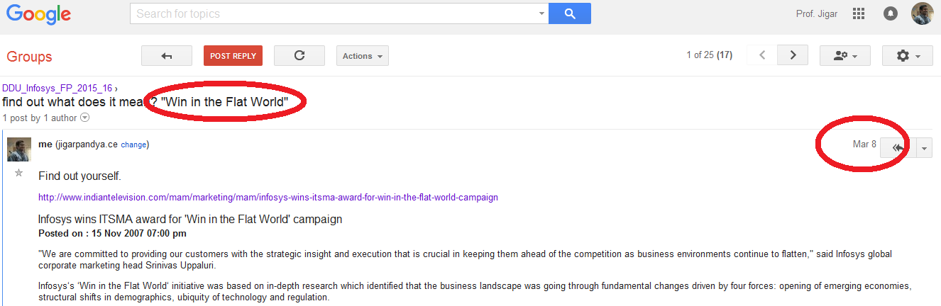
Know more to move ahead. Share most to stay ahead.
Sharing significant things anytime shows students that we care.
i.e. Even after 2 months, a small bit was shared for their betterment.
“Win in the Flat World” - Software is everywhere and business environment continues to flatten.

Slide 10
Use of technology to share
Day wise topics, material, assignments
Moodle: Course Management System for online learning and resource management
Software Setups
Ftp, Windows LAN
Information by Campus Connect on student concerns and other facts
Google Group
Student updates while undergoing the course and later as part of “Gift a Dream!!” idea to create buzz at university
WhatsApp
University Newsletter
“Gift a dream! – A gift of a dream from Infosys current interns to juniors to prepare well for next year placement”

Slide 11
Productivity
Keyboard shortcut
Important features for coding standards
Automated Tasks/Work around
For example, following was collected from students as part of learning eclipse:
PRODUCTIVITY - CHEATSHEET
Eclipse (Updated frequently)
use ctrl+space to get Template Proposals after partial typing any component i.e. Sys<Ctrl+Space>
Typing sysout and Ctrl+Space, choses System.out.println
Generate Getters and Setters automatically from the source menu for instance variable.
If you want to rename a variable all over, use right click on that variable and perform REFACTOR. It will automatically, update name everywhere(single or mutliple files) it is in use.
Multiline comments automatically, apply Ctrl+Shift+/. Revert Ctrl+Shift+\.
Ctrl+Shift+f for auto indent the current file.
Ctrl+Shift+o for discarding unused import statement.
F3 or Ctrl+LeftMousClick will show function body/ variable declaration space. To go back to previous place, press alter+left arrow.
Select an identifier and press Ctrl+U., it highlights all occurances,

Slide 12
Importance of Documentation
Students were provided with following guidelines to prepare documentation:
- Front Page
- Participant Document
- Acknowledgement
- Index
- About the Foundation Program 4.0
- About Campus Connect
- About Infosys
- About DDU
- Focus Area 1 (Object Oriented Programming using Java)
Topics’ description and assignments with solution day wise
- Focus Area 2 (Relational Database Management Systems)
Topics description and assignments with solution day wise
- Focus Area 3 (Software Engineering and Introduction to UI & Web Technologies)
Topics description and assignments with solution day wise
- Tools
3 to 5 pages of each tool with about software tool, screenshots conveying the purpose and activity (Refer to software tools section from moodle)
- Day wise activities
- Important WebSites and References

Slide 13
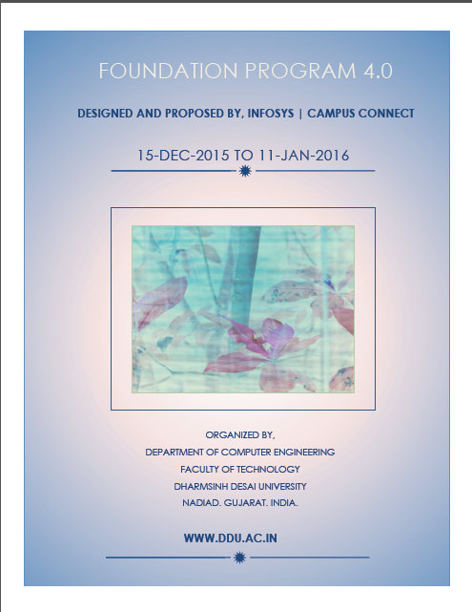

…Importance of Documentation
DDU prepared participation documents of all students automatically using mail-merge feature of Microsoft Office and provided to students to print and attach in the documentation.
This was signed by all faculties on concluding day to admire student efforts.

Slide 14
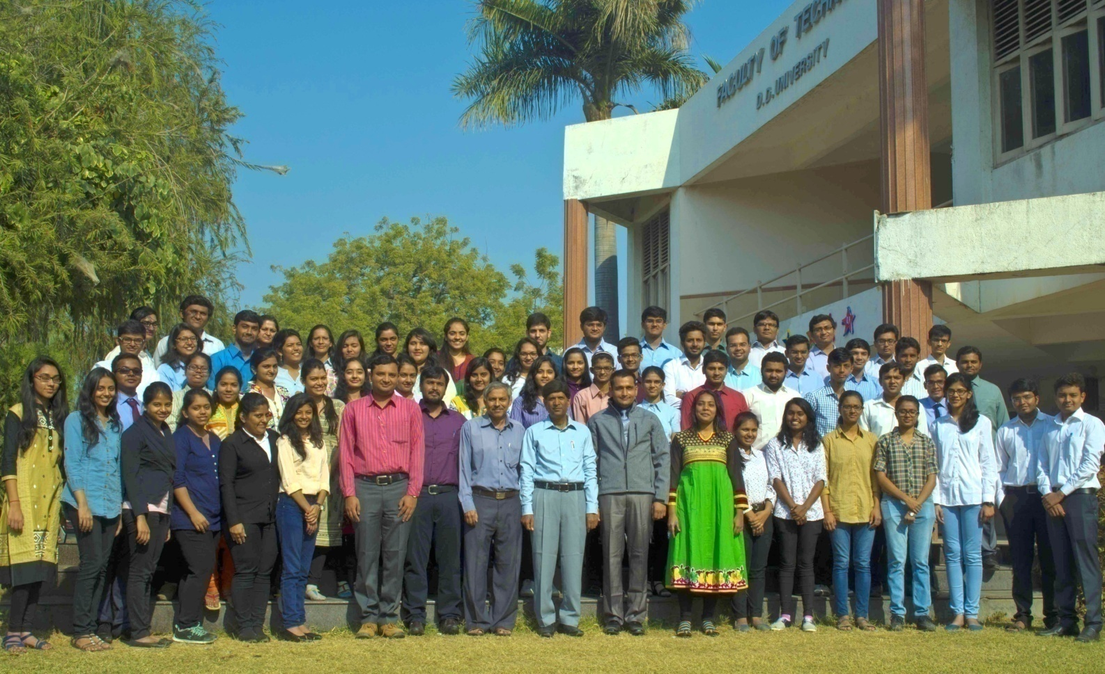
Celebrations and memories
Professional Day Group Photo

Slide 15
Thank you.

